Slide 1
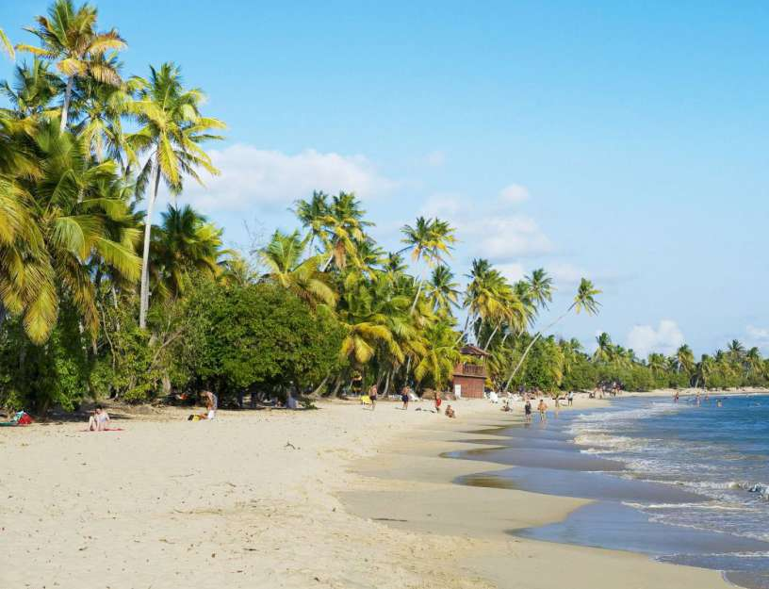
TOURISM IN MARTINIQUE
Tourism
How to come?
Housing
Top 5: favorite places for tourists

Slide 2
With more than a million tourists, Martinique recorded a record year last year.
The tourism in Martinique increased of 16.4% in 2017.
535,647 visitors were welcomed on the island as part of a tourist trip, a grow of 3.1% compared to 2016.

Slide 3
8.8%: this is the rate of European visitors (excluding French people) in Martinique in 2017 against 5.6% in 2014.
5 airlines are strengthening their service to Martinique this year.

Slide 4
6 axes of orientation have been defined by the Martinique Tourism Committee for 2018:
- develop air services
- increase awareness
- analyze and evaluate the tourism offer
- improve the digital experience
- structure the sectors
- create and support events in low season

Slide 5
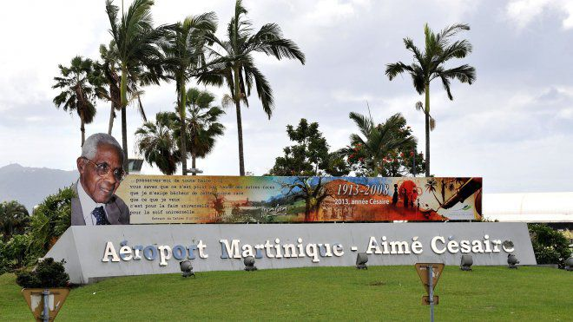
How to come?
The Martinique airport is located in Lamentin. It’s the Aime Cesaire airport.

Slide 6
Airlines
From Paris: Corsair, XL Airways, Air Caraibes and Air France.
From Montreal: Air Canada, Norwegian and Air Transat.
From the USA: Norwegian, American Airlines and Air France.

Slide 7
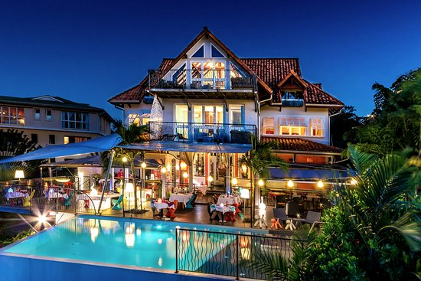
Housing
In Martinique, there is a wide choice of accomodation!
You will quickly find your happiness, and you will be comfortably accommodated in it’s heavenly island.
Whatever their location, they welcome visitors with a quality service, charm, and relaxation!

Slide 8
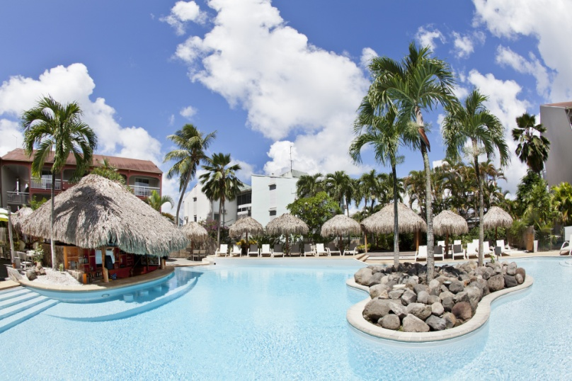
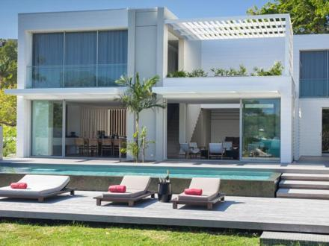
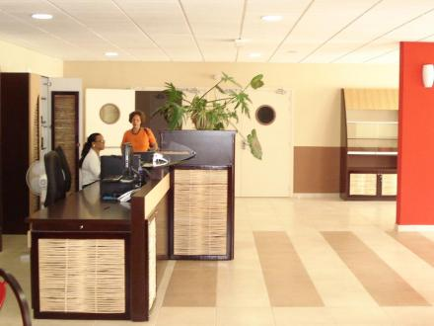
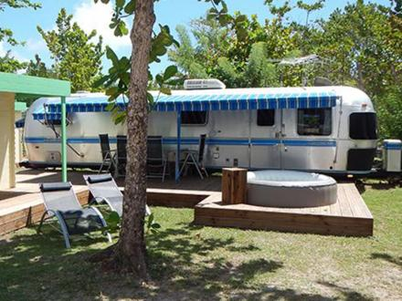
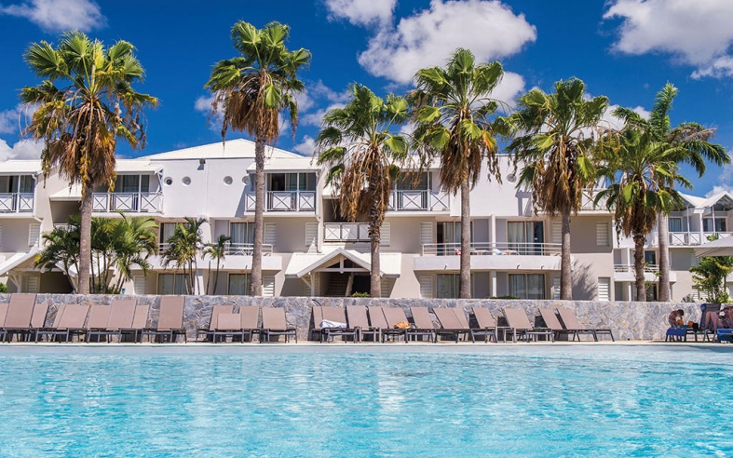
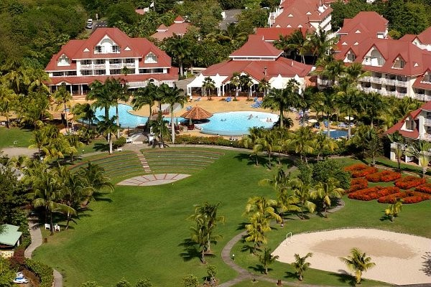
Hotel
Rental accomadation
Collective accomoda-tion
Camping
Tourist residences
Holiday villages

Slide 9
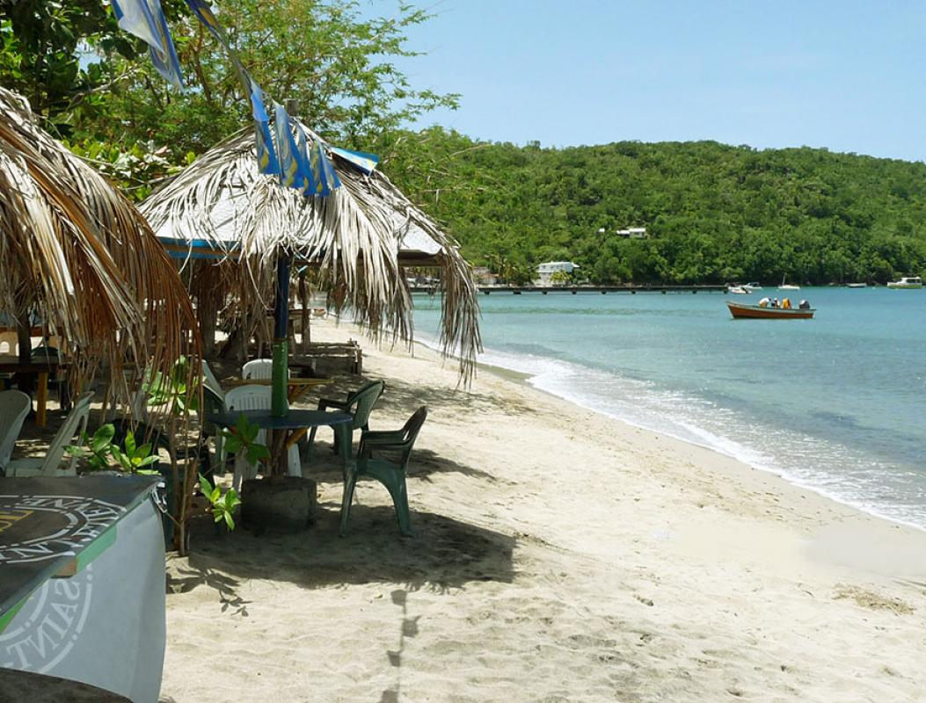
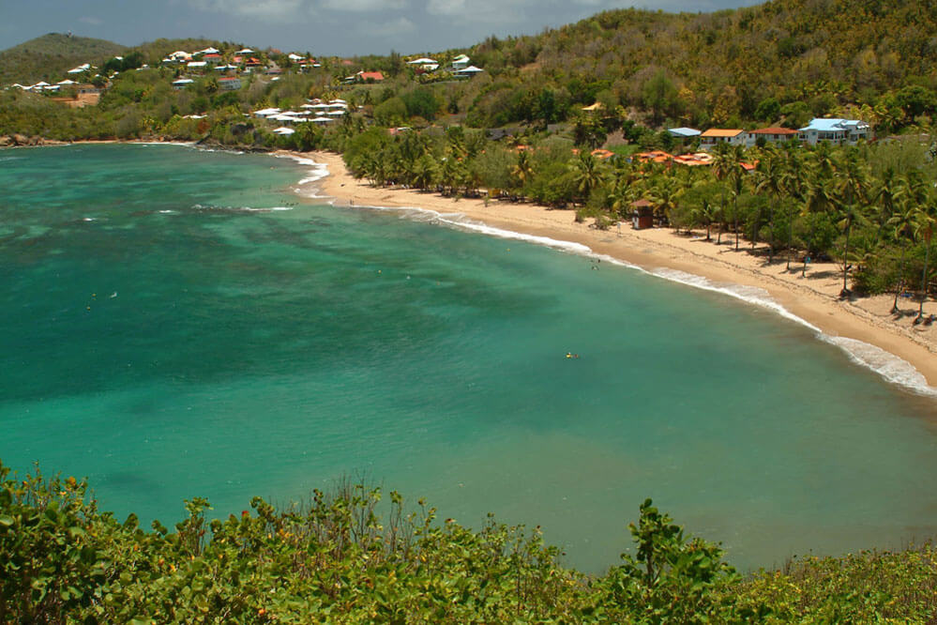
Grande Anse d’Arlet
This beach is very visited and lively at the weekend.
On the terrace of a restaurant, you can admire splendid sunsets.
Anse l’Etang
Located in the north of the peninsula Caravelle, l’Anse l’Etang is a long and beautiful fine sandy beach.

Slide 10
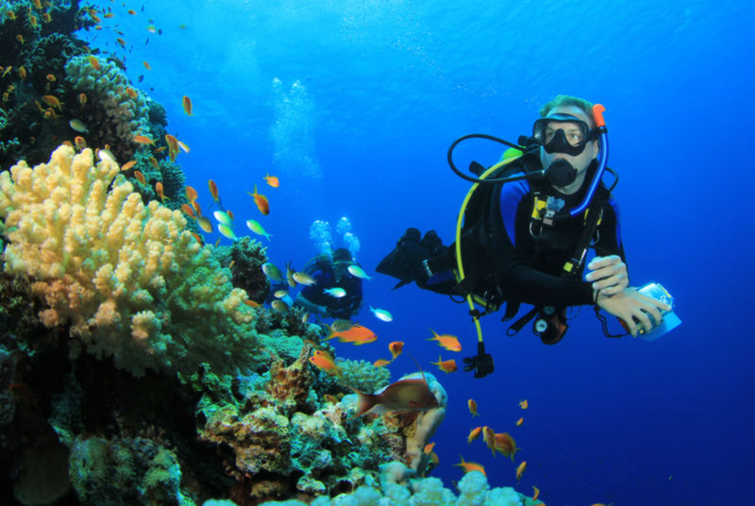
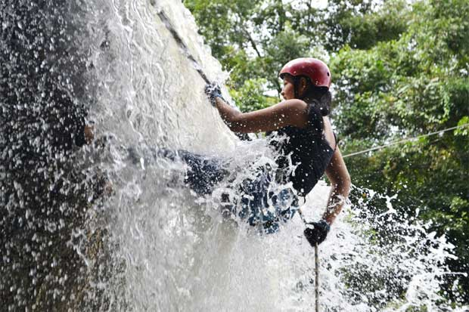
Underwater world of Martinique, is a wonderful environment to explore
Canyoning in Martinique is one of the best ways to enjoy the island, its landscapes and its tropical vegetation.

Slide 11
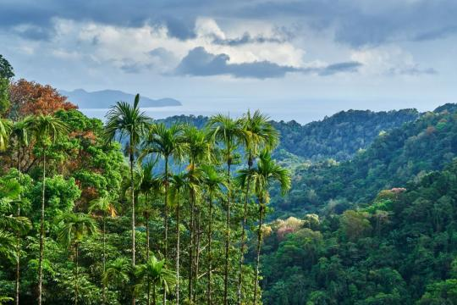
Nature in Martinique
Martinique is one of 35 global hotspots of biodiversity with a Regional Natural Park occupying two thirds of its territory! The Flower Island is committed to UNESCO World Heritage designation for its volcanic and forest areas.

Slide 12
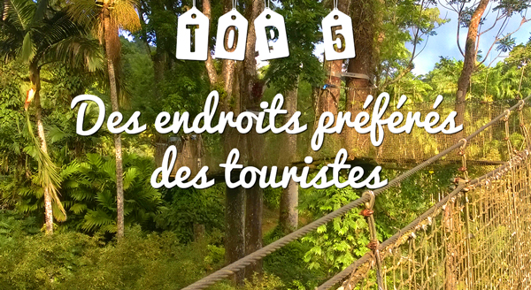
Favorite places for tourists

Slide 13
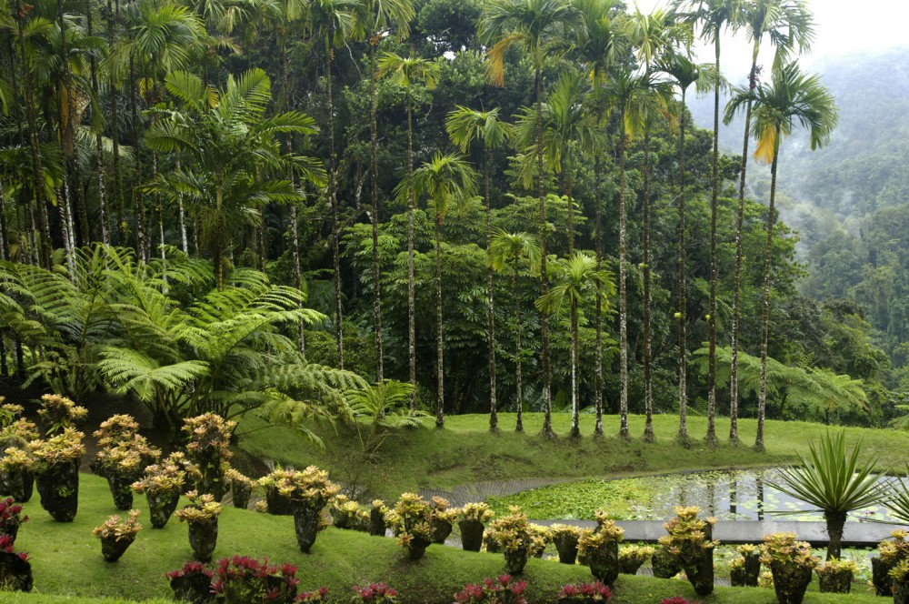
1) The Balata Garden
Mandatory visit when one goes to Martinique, the Garden of Balata is a place simply paradisiac. Hundreds of species of plants and trees are spread over a majestic site that can also be visited via suspension bridges.

Slide 14
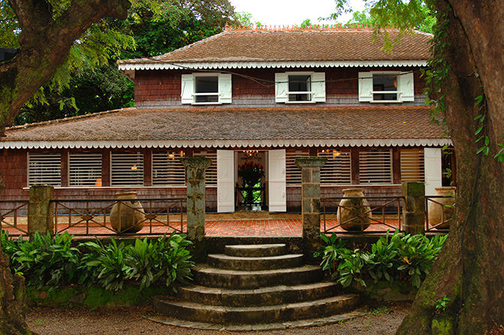
2) CLEMENT HOUSING
Martinique distillery, Habitation Clement is also the historic headquarters of Clement rums, a magnificent botanical garden and the Clement Foundation for the promotion of Caribbean arts. Visit a major site still in activity.

Slide 15
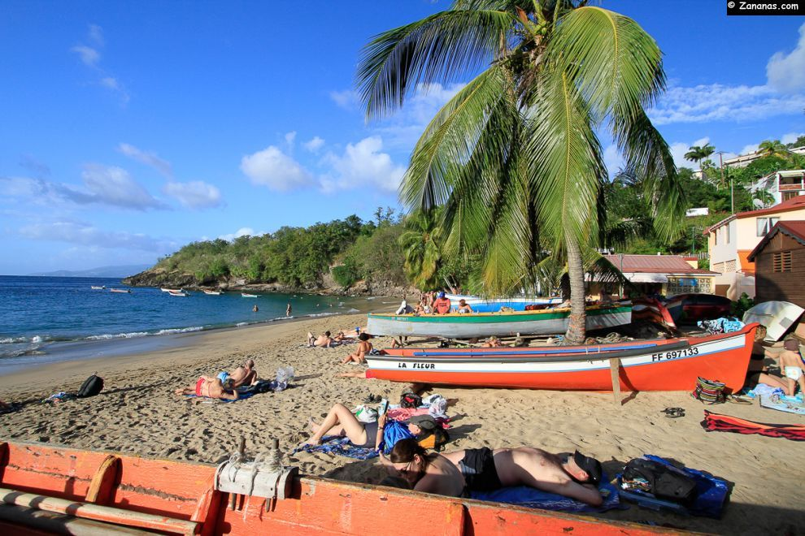
3) ANSE DUFOUR
The beach of Anse Dufour is a small beach near the Anse Noire. This white sand beach is famous for being one of the most beautiful and most typical of Martinique.

Slide 16
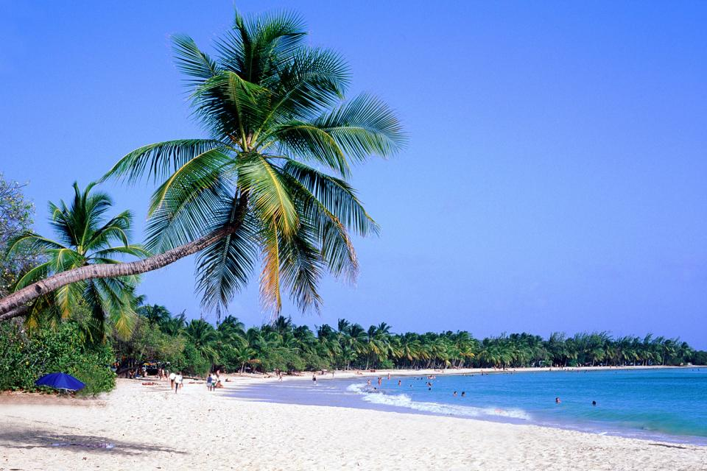
4) The Salines Beach
It is the most famous beach of the island ... and also the busiest! The beach of Salines is probably the beach "postcard" by excellence with its long strip of golden sand, coconut trees, calm and turquoise water.

Slide 17
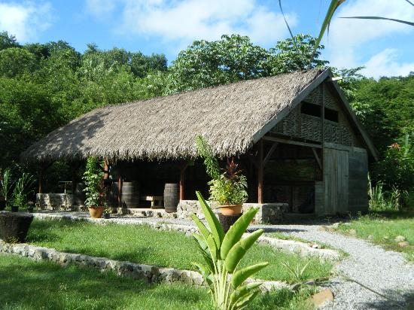
5) The Savannah of the slaves
Located in the countryside of Trois-Ilets, Savane des Esclaves is a live Museum tracing the history of slavery in Martinique. Deep in the past Martinique, this museum is composed of several boxes and guided tours that will immerse you in the life of yesteryear in Martinique.

Slide 18
I hope this presentation made you discover the island of Martinique
Thank you for your attention !!

